Slide 1
THE LOGIC GATES
INTRODUCTION TO LOGIC GATES

Slide 2
Learning objectives
At the end of this element participants should be able to;
Define the term logic gate
Identify types of logic gates
Illustrate the types of logic gate
Prepare the table for each type of logic gate
Draw logic circuits

Slide 3
1.0. Introduction to logic gates
Logic gate is an arrangement of controlled switches used to illustrate operation using Boolen logic in digital circuit.
In other words, it is an electronic circuit which makes logical decision based on combination of digital signals from its inputs.
They are primarily controlled electronically but can also be controlled by electromagnetic relays, electronic diodes, fluidics, optical or even mechanical elements.

Slide 4
2.0. Basic types of logic gates
There are three basic types of logic gates namely;
(i) AND gate
(ii) OR gate and
(iii) NOT gate
However there are some derived logic gates including;
NAND gate, NOR gate, XOR gate and XNOR gate

Slide 5
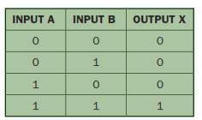
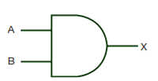
More elaboration on logic gates
AND gate: The AND gate is an electronic circuit that gives a true output i.e. (1) only if all of its inputs are true. A dot (.) is used to denote the AND gate operation i.e. A.B
The symbol and truth table appears as follows.

Slide 6
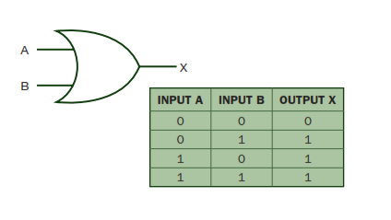
2.0. The OR gate
The OR gate is an electronic circuit that gives a true output only if one or more of its inputs are true. A plus sign is used to show the OR operation. Its symbol and truth table are as follows.

Slide 7
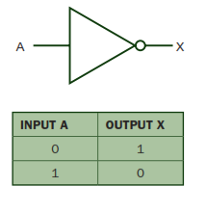
3.0. The NOT gate
The NOT gate is an electronic circuit that produces an inverted version of the input at its output. It is also known as an inverter. If the output variable is A, then its corresponding inverted output becomes Not A represented by Ā.

Slide 8
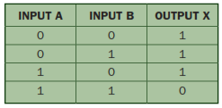

4.0. The NAND gate
This is a NOT-AND gate which is equal to an AND gate followed by a NOT gate. The output of all NAND gate are true if any of the inputs are false. The notation of an NAND gate includes a circle on the output representing an inversion

Slide 9
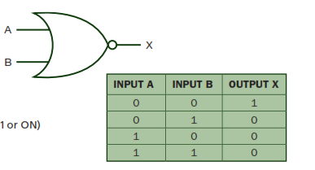
5.0. The NOR gate
This is a NOT-OR gate which is equal to an OR gate followed by a NOT gate. The outputs of all NOR gate are false if any of the inputs are true. The NOR gate has a small circle on the output to denote an inversion.

Slide 10
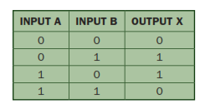
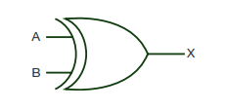
6.0. The XOR gate
The exclusive OR gate is a circuit which will give a true output if either, but not both of its two inputs are true.

Slide 11


7.0. The XNOR gate
The exclusive –NOR gate circuit does the opposite to the XOR gate. It will give a false output if either, but not both of its two inputs are true. The small circle to its output denotes an inversion

Slide 12
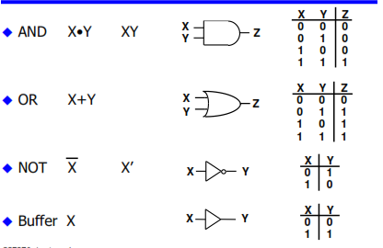
3.0. Logic gates and truth tables

Slide 13
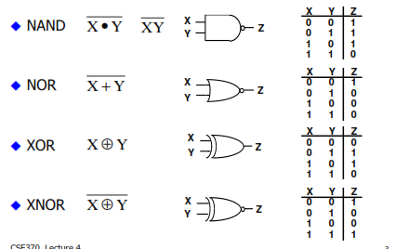
Logic gates and truth table cont…..

Slide 14
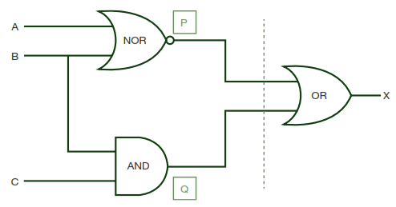
Worked examples
1. Produce a truth table for the following logic circuit.

Slide 15
Example 1 cont……
1st step: There are three inputs A, B and C, thus we must have 2³ i.e. (8) possible combinations of 1’s and o’s. To find the values of output at points P and Q, it is necessary to consider the truth tables for the NOR gate (output P) and the NAD gate (output Q).
P = A NOR B and Q = B AND C

Slide 16
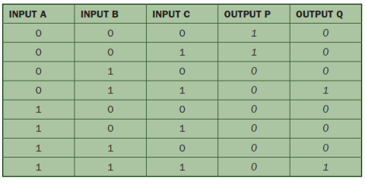
Example 1. cont…

Slide 17
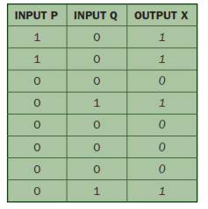
Example 1 cont….
2nd step. There are 8 value from P and Q which form the input to the last OR gate. Hence we get X = P OR Q which gives the following truth table.

Slide 18
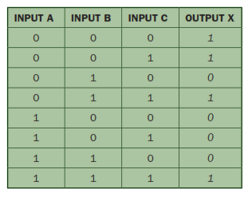
Example 1 cont…..
Thus the final truth table becomes;

Slide 19
Example 2.0.
A system uses 3 switches A,B and C, a combination of switches determine whether an alarm sounds. If switch A or switch B are in the ON position and if switch C is in the OFF position then a signal will be received to sound an alarm X is produced. Prepare a truth table and the logic circuit

Slide 20
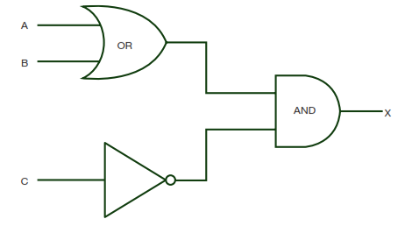
Example 2 cont…….
If (A=1 or B=1) AND (C = NOT 1) then X = 1.
A OR B gate joined with NOT C and these becomes the inputs to the AND gate which gives an output X.

Slide 21
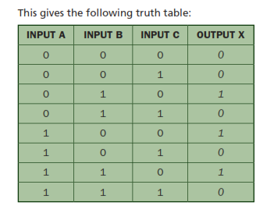
Example 2 cont…….

Slide 22
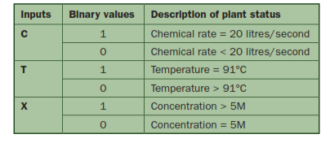
Example 3.
A chemical process gives out a warning signal (W=1) when the process operate incorrectly. A logic circuit is used to monitor the process and determine whether W=1 basing on the following conditions as tabulated below.

Slide 23
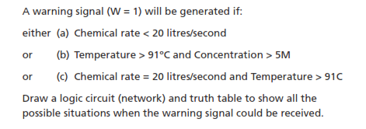
Example 3 cont …….

Slide 24
Example 3 cont …..
Step 1. writing a problem in a logic statement.
let, C =Chemical rate
T = Temperature and
X = Concentration
Then re- writing the problem in logical statement;
(C = NOT 1 ) OR (T = NOT 1 AND X = 1)
OR
(C = 1 AND T NOT 1)

Slide 25
Logic circuit (network)
Its corresponding logic circuit becomes
X
T
C
W

Slide 26
Truth table
Its corresponding truth table becomes:
T | C | X | W
0 | 0 | 0 | 1
0 | 0 | 1 | 1
0 | 1 | 0 | 1
0 | 1 | 1 | 1
1 | 0 | 0 | 1
1 | 0 | 1 | 1
1 | 1 | 0 | 0
1 | 1 | 1 | 0

